Slide 1

Only for you - relevant board game suggestions from BoardGameGeek.com
Sanni Isokirmo, Ahti Katiska, Miika Mäki

Slide 2
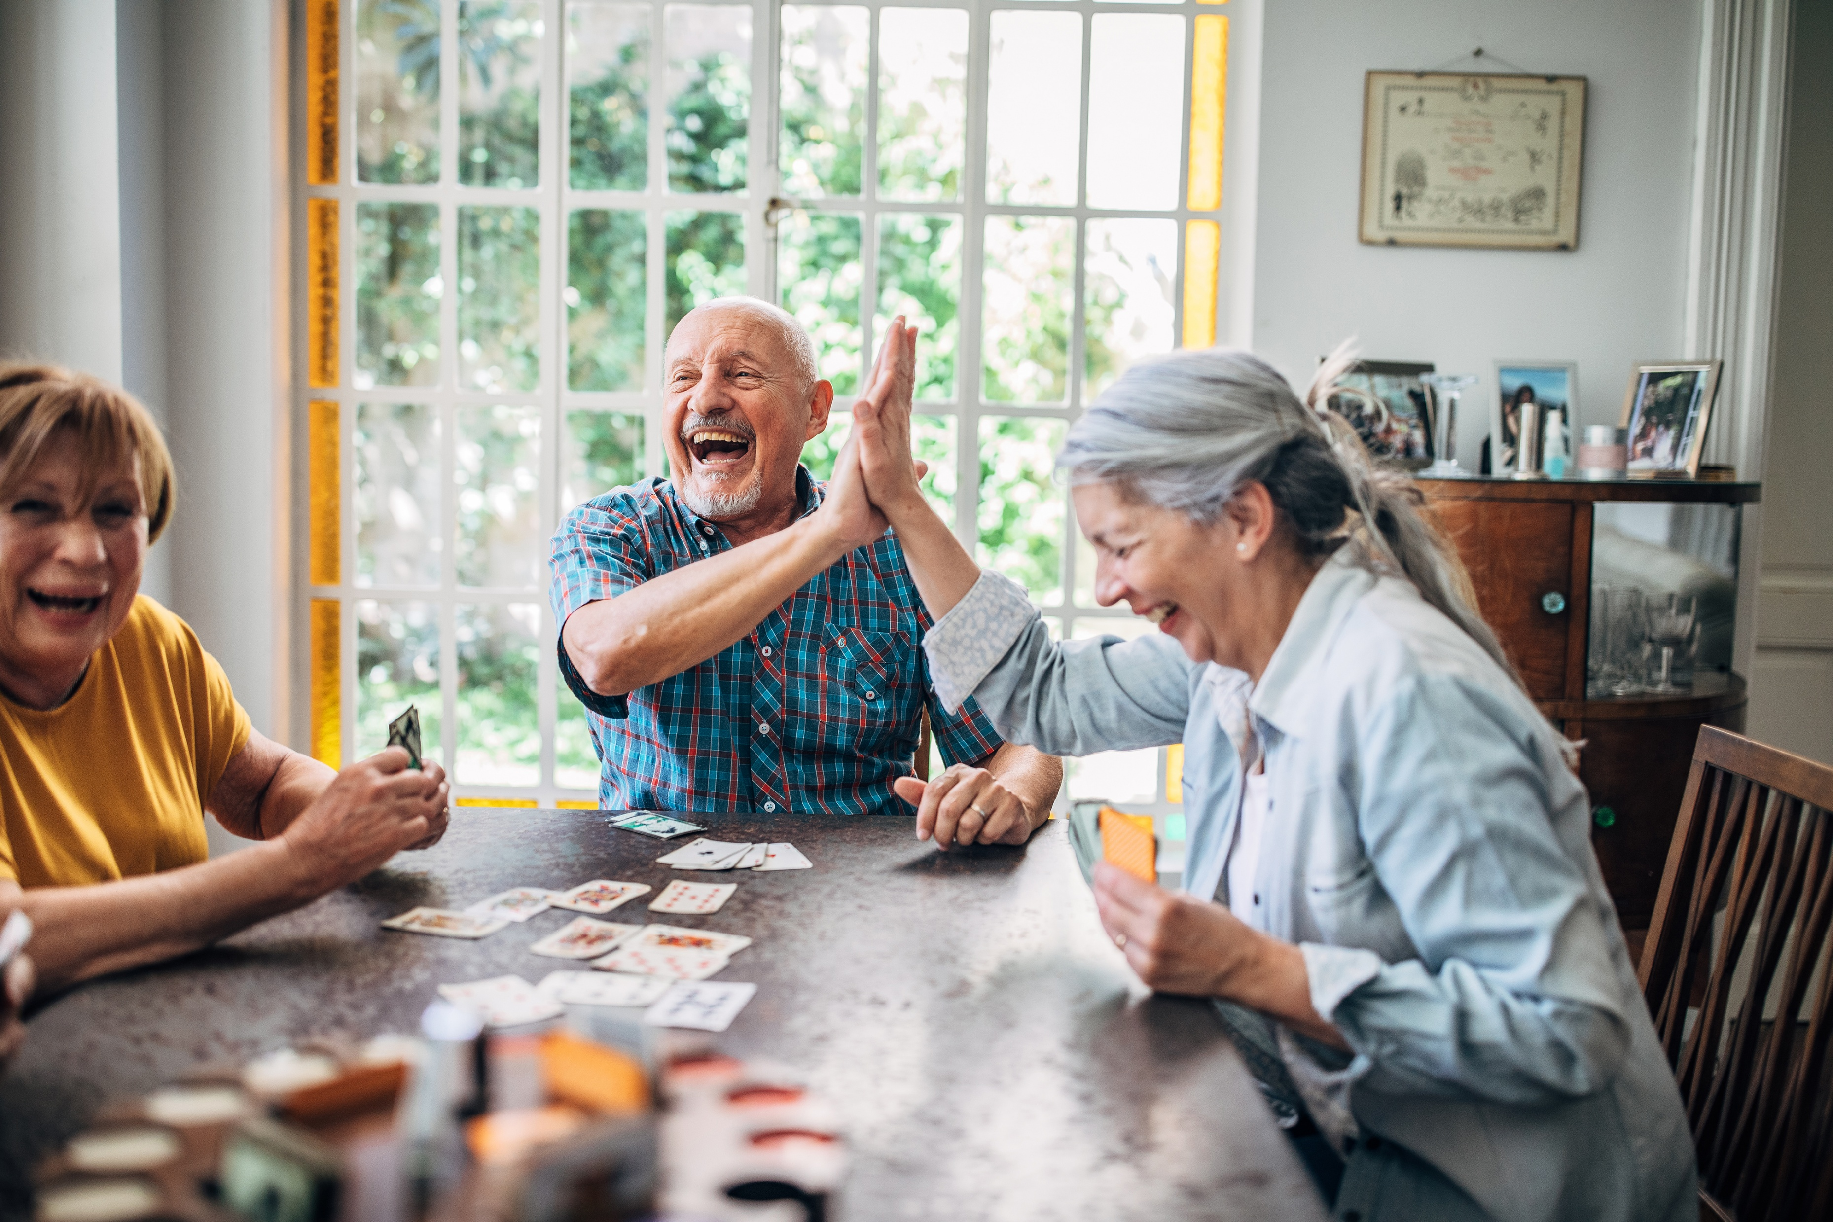

Slide 3


Slide 4


Slide 5
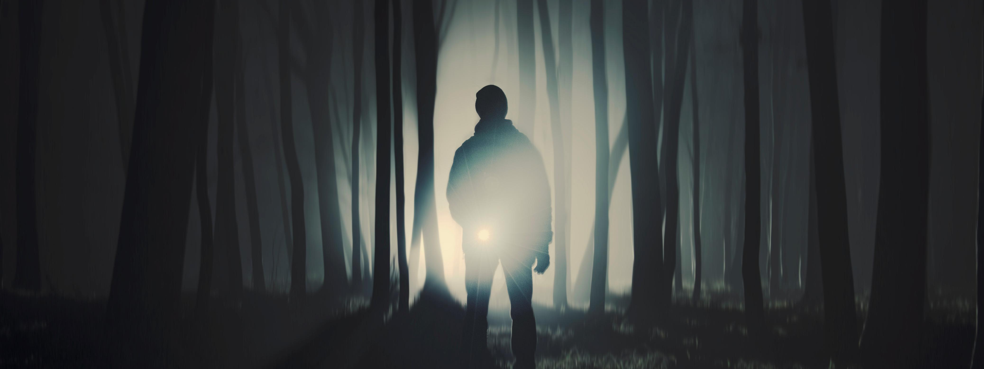
You are not alone!

Slide 6
*Video/demo*

Slide 7

Notes:
Why this, you, know?

Slide 8

Game on!

